Slide 1
From clouds to cores to envelopes to disks a multi-scale view of magnetized star formation
Chat Hull
University of California, Berkeley
Radio Astronomy Laboratory
18 October 2013
Harvard/CfA RG Lunch Talk
Cambridge, Mass.
Notes:
Star formation regions

Slide 2
Outline
Magnetized star formation
B-fields vs. outflows: multi-scale comparisons
Outflows/jets/disks and B-fields are randomly aligned (or perhaps ⟂?)
TADPOL survey
CARMA 1mm full-Stokes polarization system
B-fields: multi-scale comparisons
Cloud → core → envelope → disk
Two populations of cores: high and low polarization fraction
Back to outflows!
Disk formation implications
Star-forming regions

Slide 3
Scales of star formation
> 1 pc
0.1 pc
1000 AU
< 100 AU
cloud
core
envelope
disk

Slide 4
Outline
Magnetized star formation
B-fields vs. outflows: multi-scale comparisons
Outflows/jets/disks and B-fields are randomly aligned (or perhaps ⟂?)
TADPOL survey
CARMA 1mm full-Stokes polarization system
B-fields: multi-scale comparisons
Cloud → core → envelope → disk
Two populations of cores: high and low polarization fraction
Back to outflows!
Disk formation implications
Star-forming regions

Slide 5
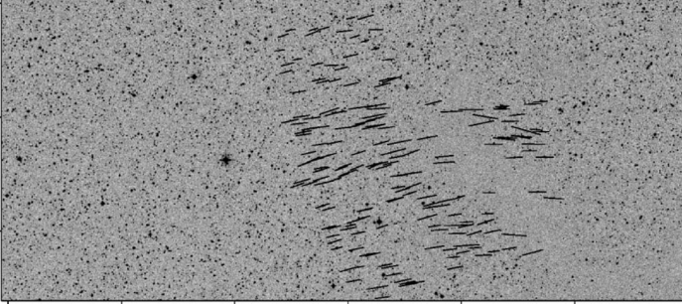
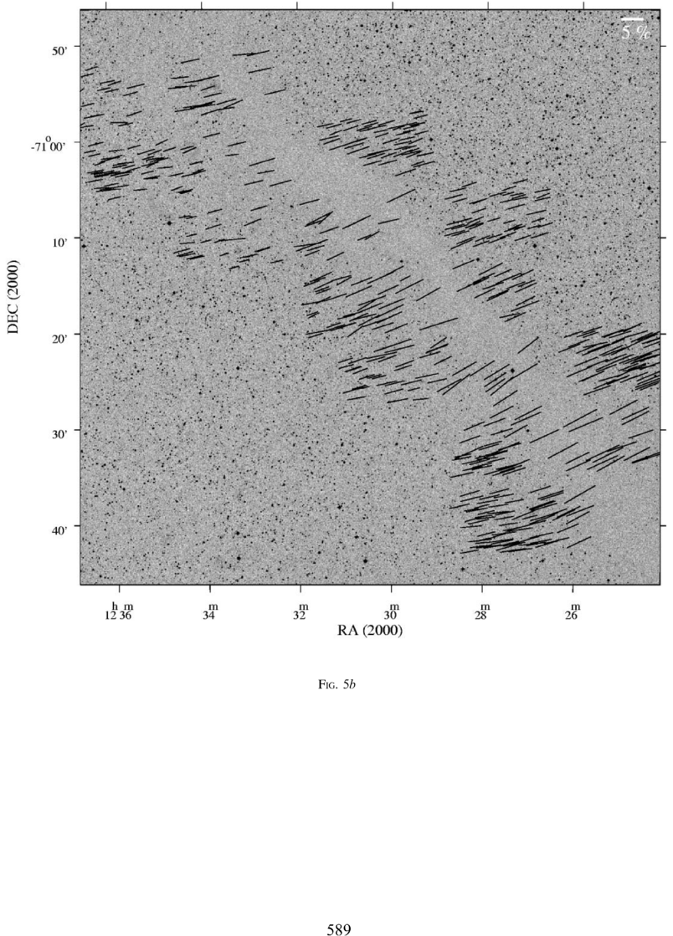
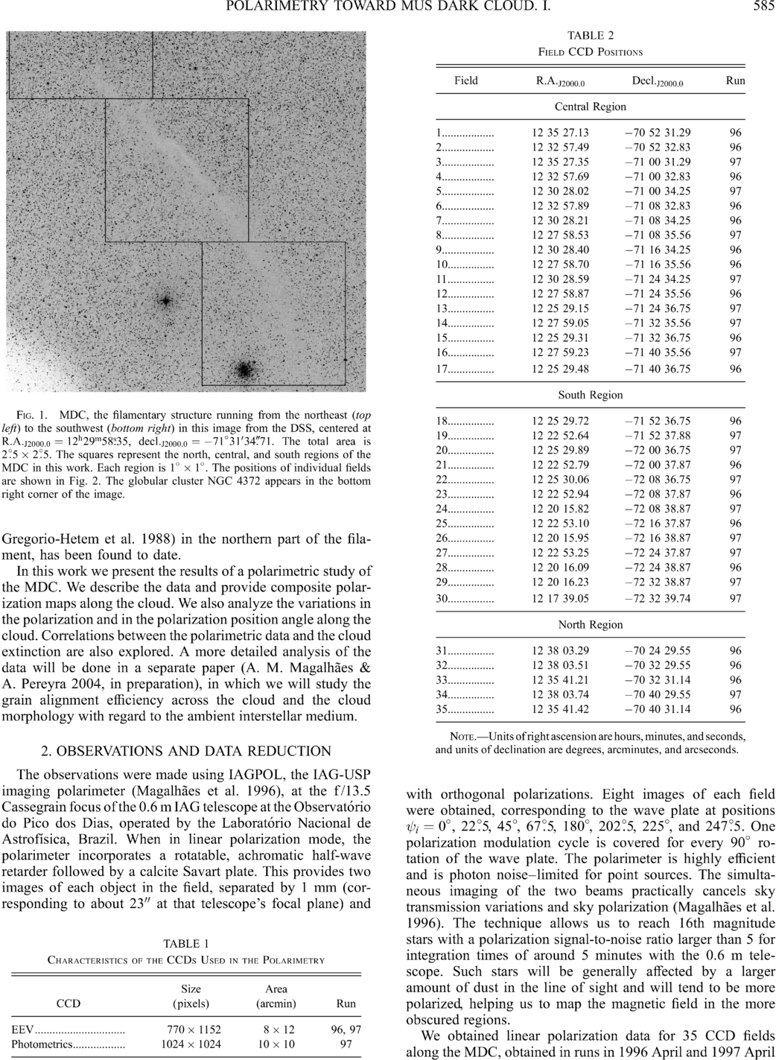
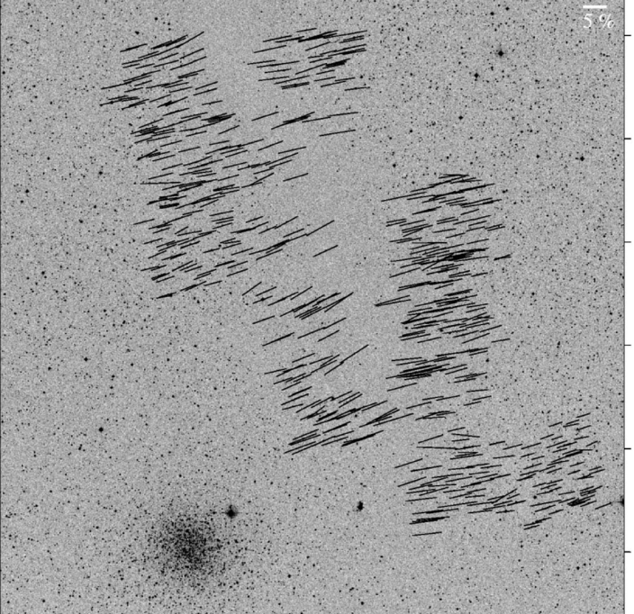
Large-scale: ordered fields
Musca dark cloud
10 pc
E,B
Pereyra & Magalhães 2004
Notes:
-Distance: 250 pc
-Mass: 250 solar masses
-Length ~10 pc

Slide 6


What is the role of magnetic fields in star formation?
Incidental?
Fundamental?

Slide 7
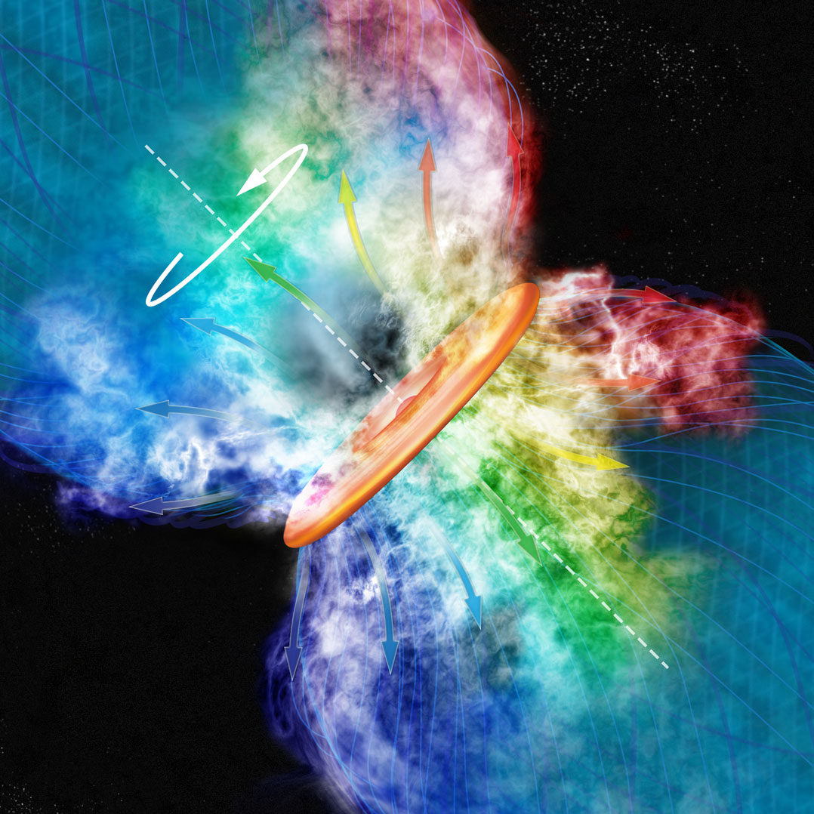
Credit: Bill Saxton, CfA

Slide 8
Outline
Magnetized star formation
B-fields vs. outflows: multi-scale comparisons
Outflows/jets/disks and B-fields are randomly aligned (or perhaps ⟂?)
TADPOL survey
CARMA 1mm full-Stokes polarization system
B-fields: multi-scale comparisons
Cloud → core → envelope → disk
Two populations of cores: high and low polarization fraction
Back to outflows!
Disk formation implications
Star-forming regions

Slide 9
Multi-scale comparisons: B-fields vs. outflows
1 pc
0.1 pc
1000 AU
100 AU
RANDOM
Ménard & Duchêne 2004
Targon+ 2011

Slide 10
Misalignment of B-fields and disks/jets
Comparing orientations of large-scale B-field with disks/jets in T Tauri stars
1
Ménard & Duchêne 2004
Cumulative Distribution Function (CDF)
0
0º
90º
𝜽_{disk/jet} – 𝜽_{B-field} (deg)
10 pc

Slide 11
Misalignment of B-fields and disks/jets
1
CDF
~1 pc
Targon+ 2011
0
0º
𝜽_{jet} – 𝜽_{B-field} (deg)
90º

Slide 12
Multi-scale comparisons: B-fields vs. outflows
1 pc
0.1 pc
1000 AU
100 AU
RANDOM
Ménard & Duchêne 2004
Targon+ 2011

Slide 13
Multi-scale comparisons: B-fields vs. outflows
1 pc
0.1 pc
1000 AU
100 AU
RANDOM
Curran & Chrysostomou 2007

Slide 14
Misalignment of B-fields and outflows
Comparing B-fields with outflows on the core (~0.1 pc) scale
B
CDF
~0.25 pc
Curran & Chrysostomou 2007
𝜽_{outflow} – 𝜽_{B-field} (deg)

Slide 15
Multi-scale comparisons: B-fields vs. outflows
1 pc
0.1 pc
1000 AU
100 AU
RANDOM
Curran & Chrysostomou 2007

Slide 16
Multi-scale comparisons: B-fields vs. outflows
1 pc
0.1 pc
1000 AU
100 AU
RANDOM
Or preferentially ⟂ ?
Hull+ 2013a

Slide 17
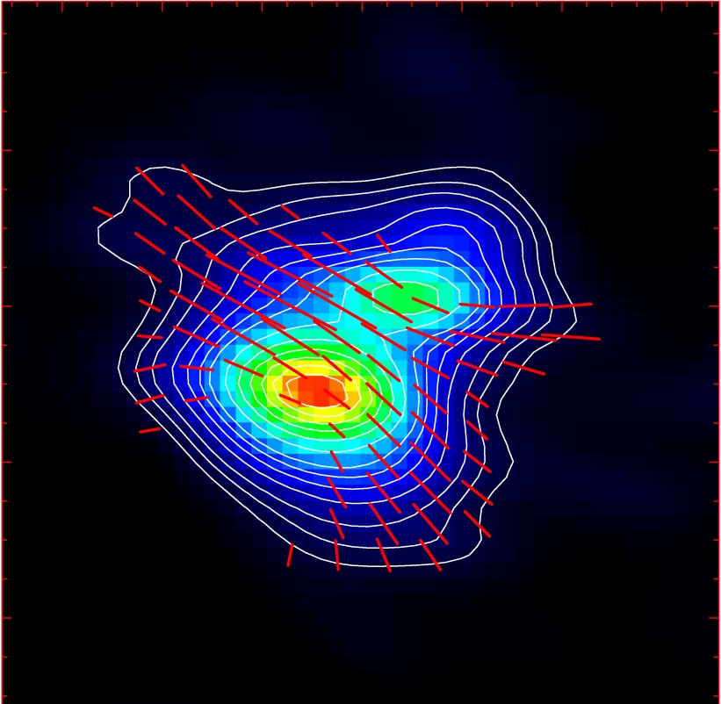
Misalignment of B-fields and outflows
IRAS 16293
NGC 1333-IRAS 4A
B-field
Rao+ 2009
Girart+ 2006
Outflow
Notes:
ROTATION: IRAS 16293 has rot/grav < 0.1; IRAS4A seems the same (barely any rotation); VLA 1623 questionable (probably slow)
-Holland: JCMT data
-Rao, Girart: SMA
-This is okay, according to Hennebelle & Ciardi ‘09 (easier to form disks with obliquity!)
-Ward-Thompson et al (2009) saw a 30 deg offset between short axes of cores and their polarization directions…another problem!

Slide 18
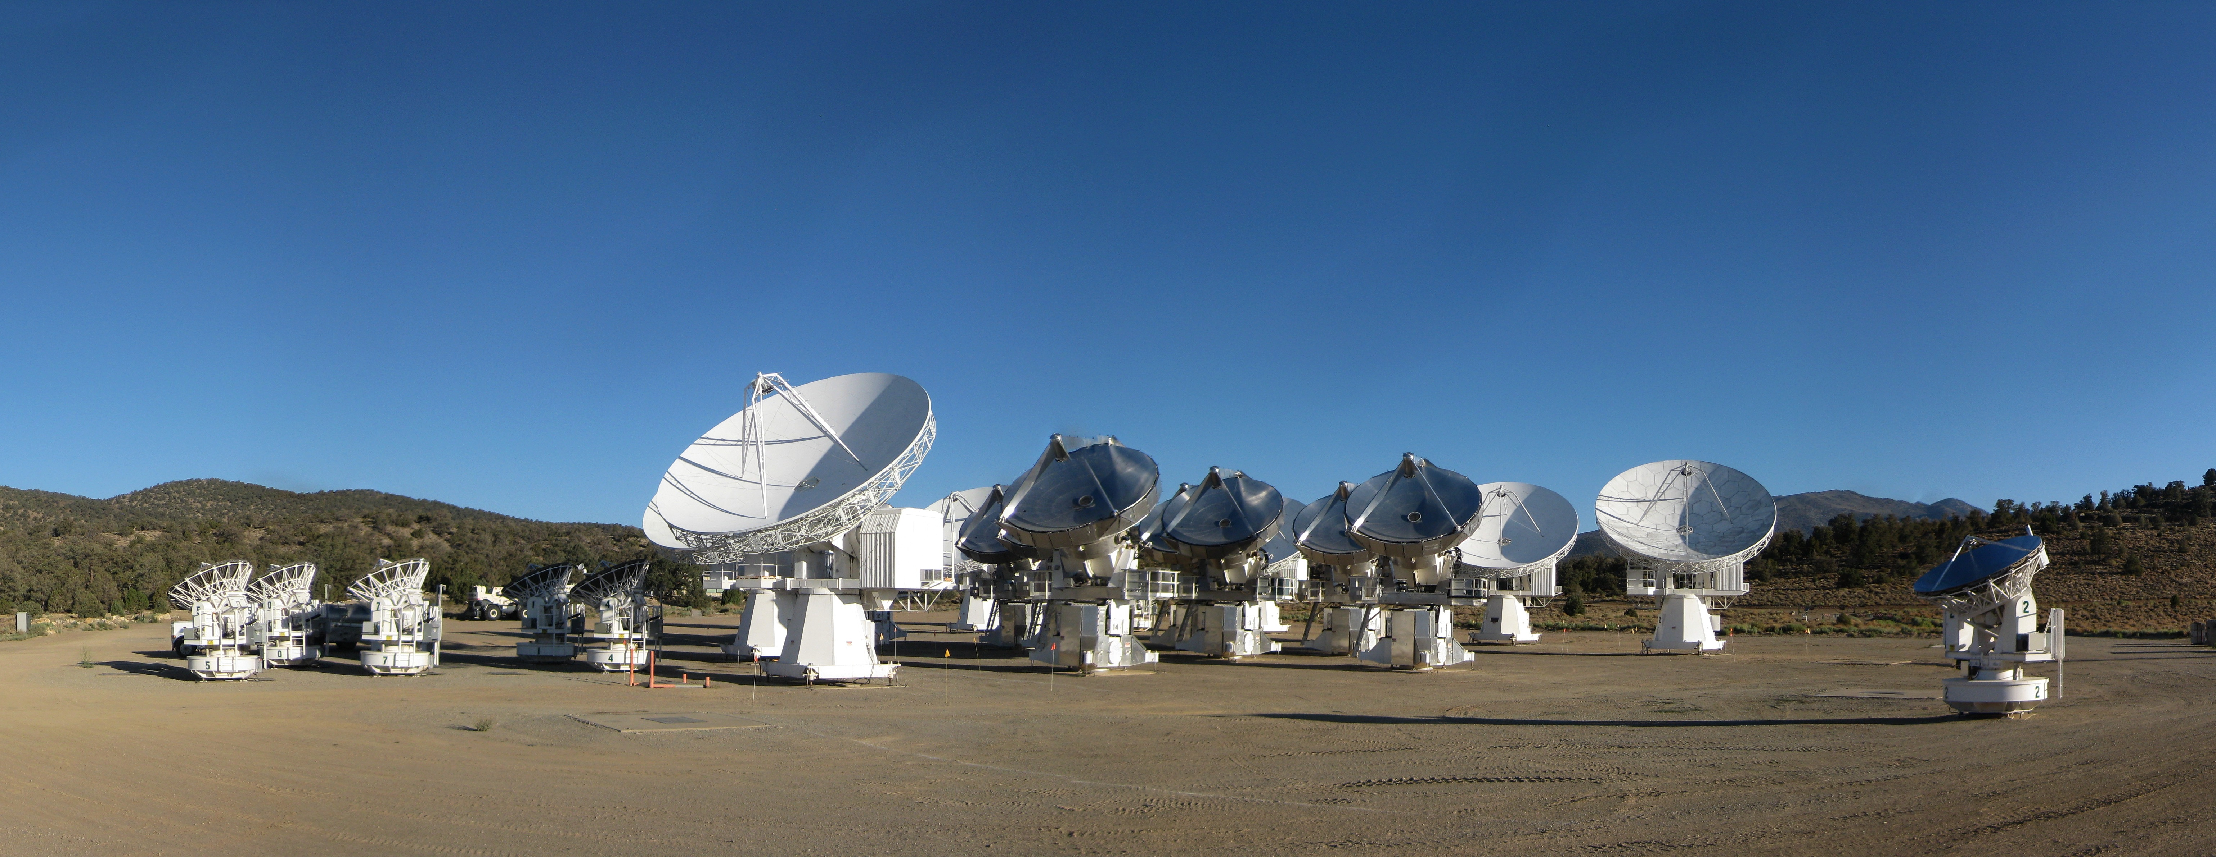
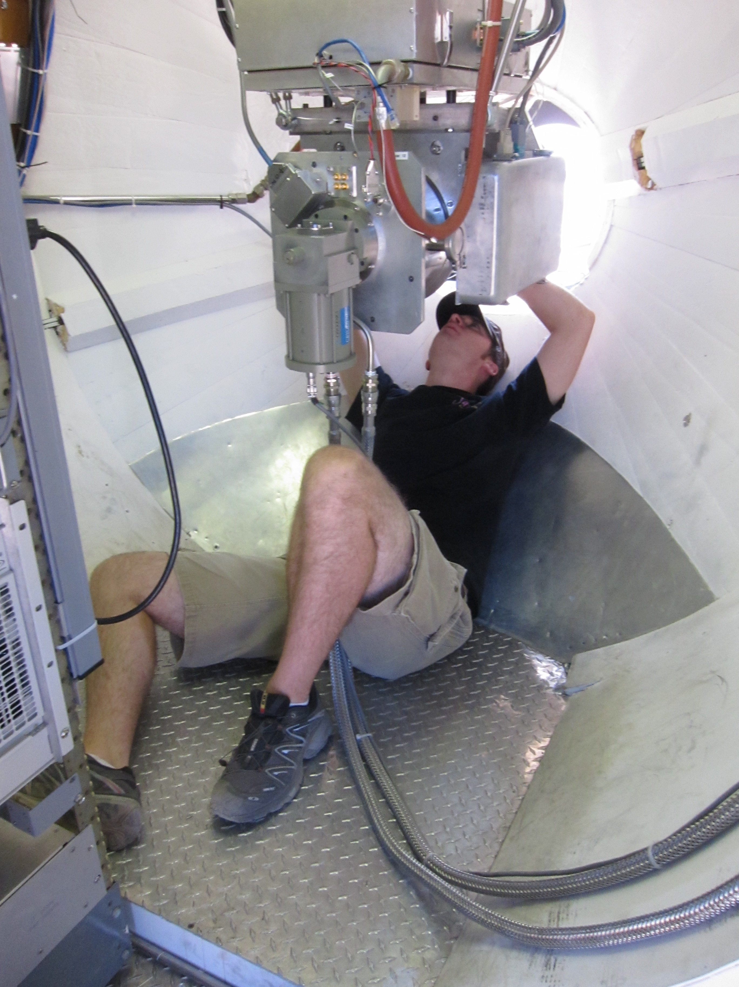
CARMA Combined Array for Research in Millimeter-wave Astronomy Consortium: Berkeley, Caltech, Illinois, Maryland, Chicago
6 ⨯10-m, 9 ⨯ 6-m, and 8 ⨯ 3.5-m telescopes
Observations at 1 cm, 3 mm, and
1 mm (polarization!)
Located in Cedar Flat, CA (near Bishop)
Notes:
SMA: 8*6m antennas = 226 m^2
CARMA: 6*10m, 9*6m = 726 m^2 (more than factor of 3 more area)
-Factor of two more dishes
-Equivalent T_sys?

Slide 19
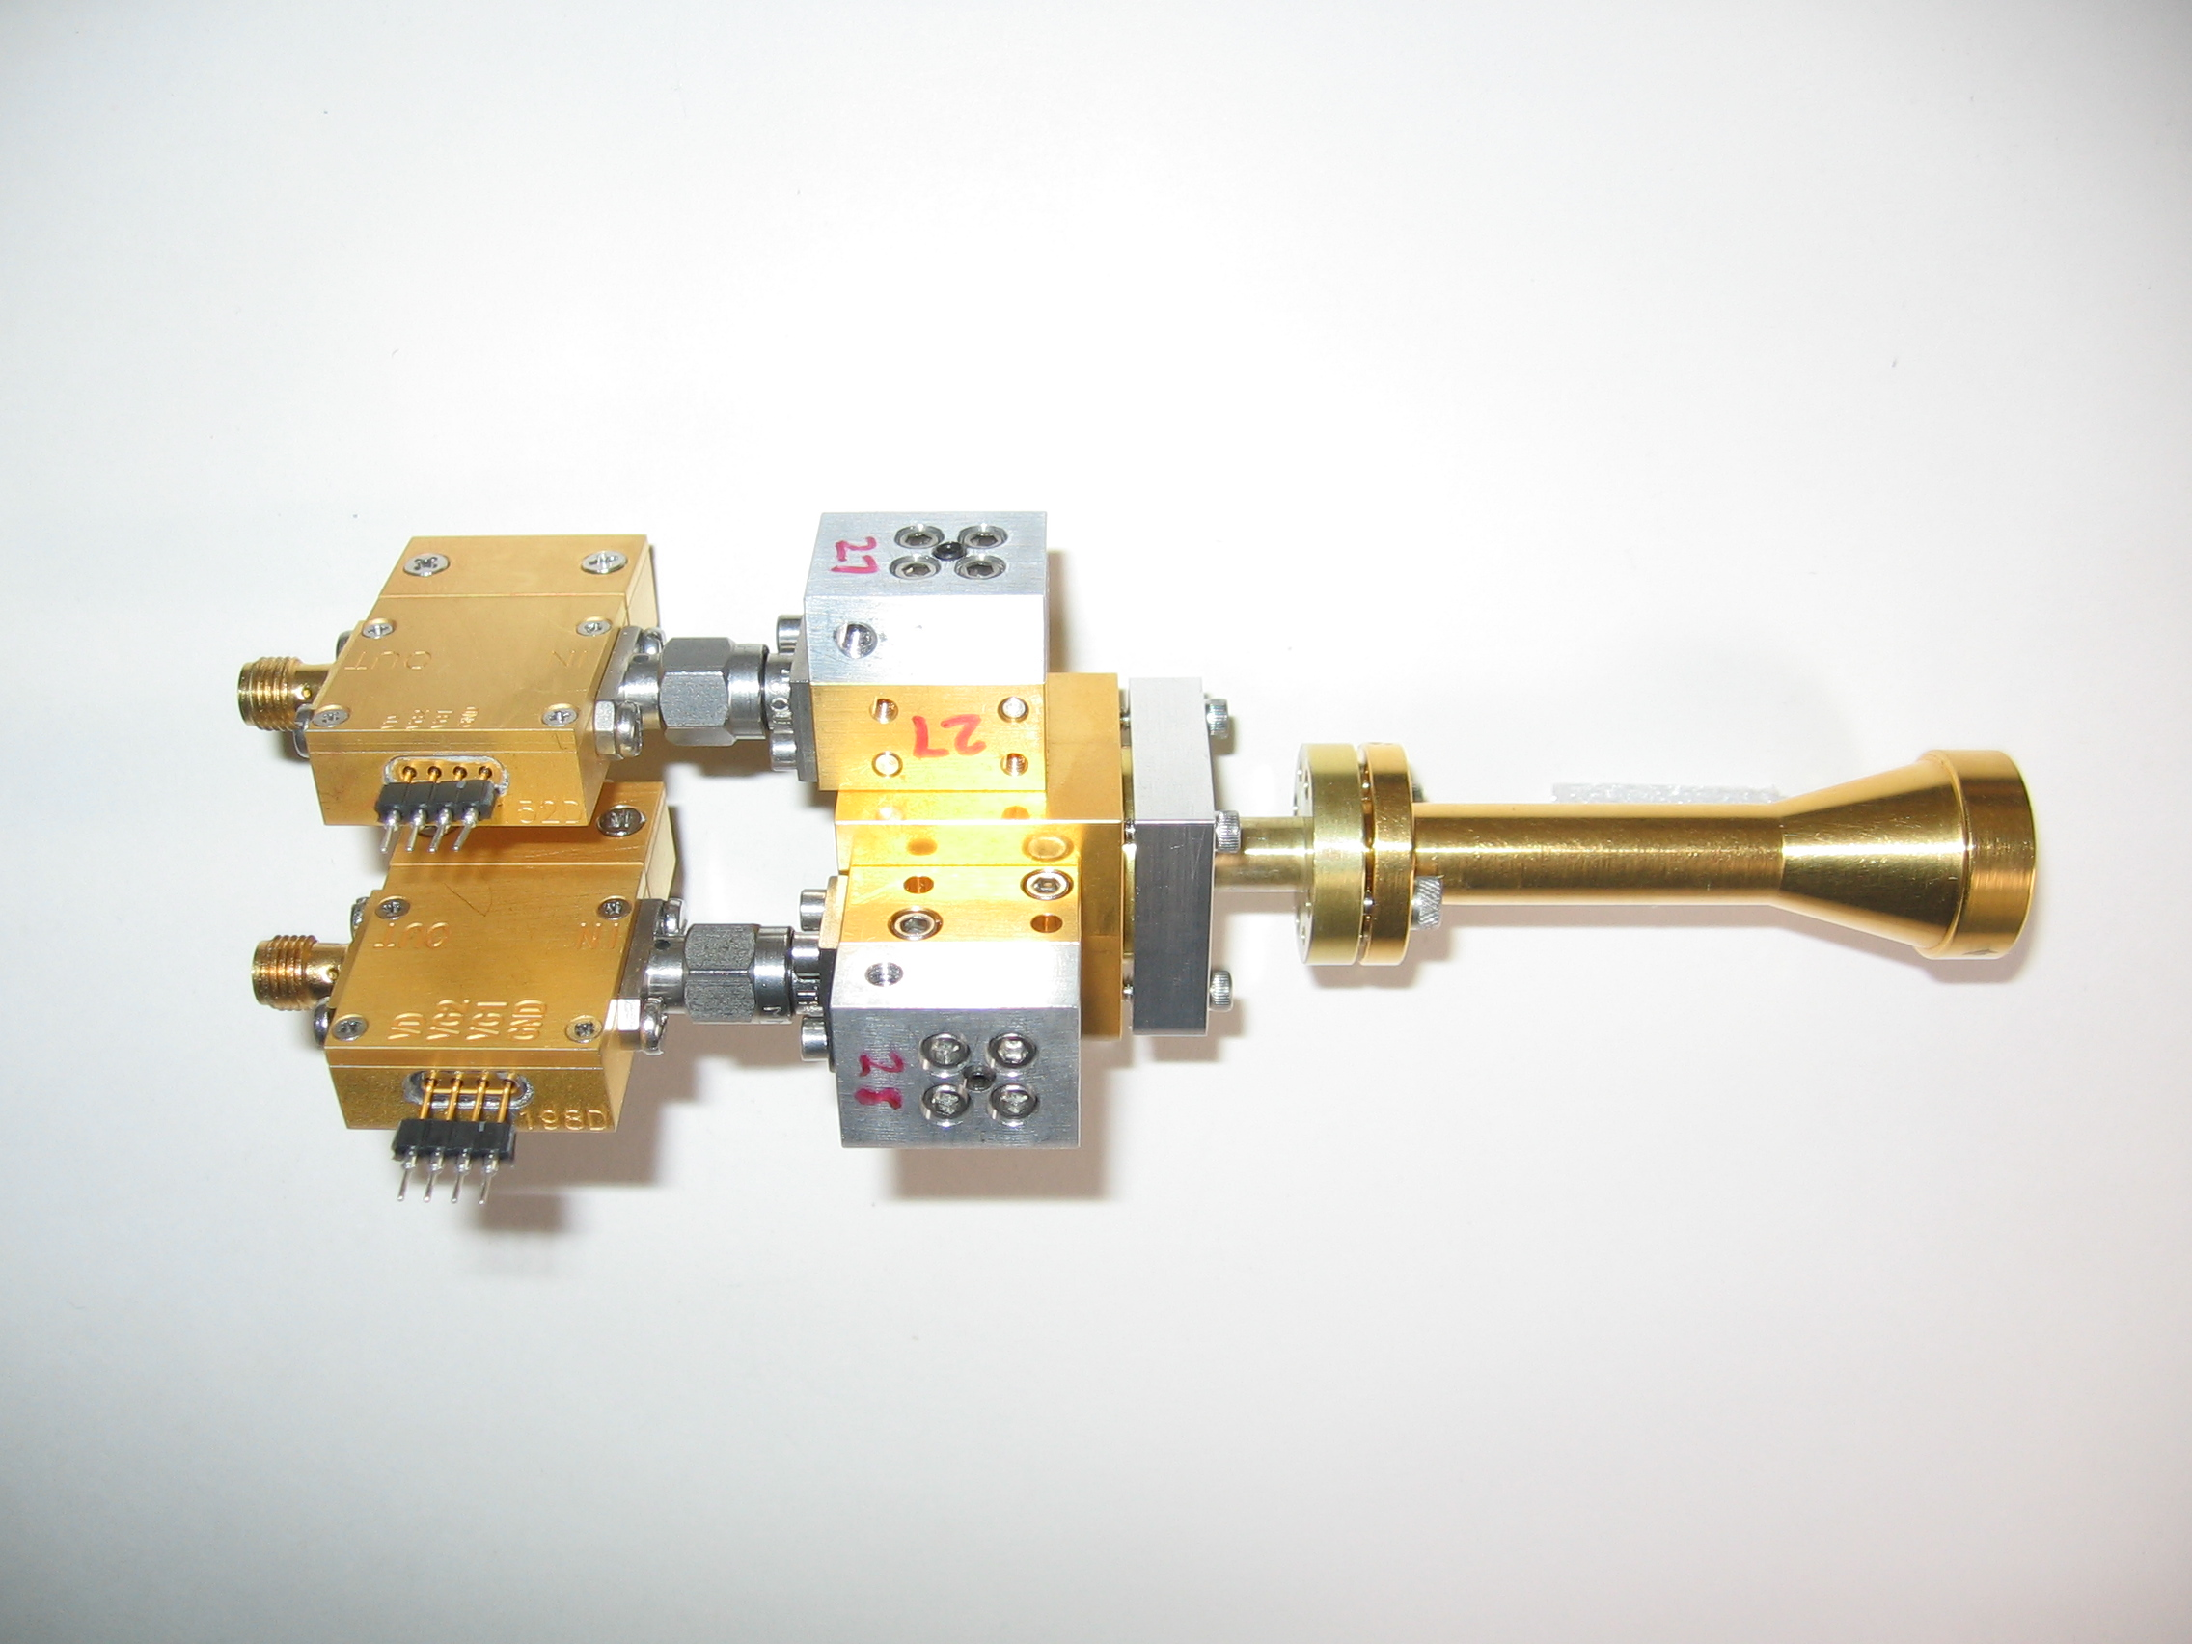
1 mm dual-polarization receivers
SIS mixers
Orthomode transducer
Waveguide circular polarizer
1 inch
WBA13
I.F. amplifiers (1-9 GHz)
Credit: Dick Plambeck
Notes:
-Sensitive to RCP & LCP
-Null experiment: in the absence of linear polarization, you get no RL correlation at any time.
-If you have linear feeds, you have XY correlation sometimes (when the intrinsic polarization is at 45º to your two feeds), and not other times (when it’s along one feed or the other). Thus, to tease out the polarization, you need stable gains

Slide 20
Misalignment of B-fields and outflows
IRAS 16293
NGC 1333-IRAS 4A
B-field
Rao+ 2009
Girart+ 2006
Outflow
Notes:
ROTATION: IRAS 16293 has rot/grav < 0.1; IRAS4A seems the same (barely any rotation); VLA 1623 questionable (probably slow)
-Holland: JCMT data
-Rao, Girart: SMA
-This is okay, according to Hennebelle & Ciardi ‘09 (easier to form disks with obliquity!)
-Ward-Thompson et al (2009) saw a 30 deg offset between short axes of cores and their polarization directions…another problem!

Slide 21
TADPOL survey

Slide 22
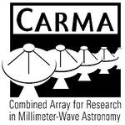














TADPOL collaboration
UC Berkeley
Chat Hull (PI), Dick Plambeck, Mel Wright, Carl Heiles, Geoff Bower
University of Maryland
Marc Pound, Alberto Bolatto, Katherine Jameson,
Lee Mundy
Caltech
Thushara Pillai, John Carpenter, James Lamb,
Nikolaus Volgenau
University of Illinois, Urbana-Champagne
Leslie Looney, Dick Crutcher, Nick Hakobian
Other
Dan Marrone (Arizona), Meredith Hughes (Wesleyan), John Vaillancourt & Göran Sandell (USRA-SOFIA), John Tobin (NRAO), Ian Stephens (BU), Jason Fiege & Erica Franzmann (Manitoba), Martin Houde (UWO, Caltech), Brenda Matthews (NRC-CNRC), Woojin Kwon (SRON)

Slide 23
TADPOL survey
37 sources
Largest survey of star-forming cores to date
>500 observing hours
CARMA C, D, & E arrays
1 – 4" resolution
10⨉ higher resolution than CSO & JCMT
Probes intermediate region between ~0.1 pc (single-dish)
and ~100 AU (ALMA)

Slide 24
TADPOL results
L1157
2″
See also: Stephens+ 2013, ApJL, 769, L15
Notes:
NEARBY SF regions:
-Perseus (NGC 1333, L1448, SVS13): 235 pc (masers in SVS13) → 03:30 LST
-Taurus (DG Tau, L1527): 140 pc → 04:30 LST
-Orion: 400 pc → 05:30 LST
-Serpens: 415 pc → 18:30 LST
-Ophiuchus: 140 pc → 17:00 LST
-Cepheus (L1157): 250 pc → 22:00 LST
-Isolated (B335, Bok globule): 250 pc

Slide 25
Credit: Bill Saxton, CfA

Slide 26
TADPOL results
NGC 1333-IRAS 4A
NGC 1333-IRAS 4B, 4B2
2″
2″
Notes:
NEARBY SF regions:
-Perseus (NGC 1333, L1448, SVS13): 235 pc (masers in SVS13) → 03:30 LST
-Taurus (DG Tau, L1527): 140 pc → 04:30 LST
-Orion: 400 pc → 05:30 LST
-Serpens: 415 pc → 18:30 LST
-Ophiuchus: 140 pc → 17:00 LST
-Cepheus (L1157): 250 pc → 22:00 LST
-Isolated (B335, Bok globule): 250 pc

Slide 27
TADPOL results
L1527
NGC 1333-IRAS 2A
2″
3″
Notes:
NEARBY SF regions:
-Perseus (NGC 1333, L1448, SVS13): 235 pc (masers in SVS13) → 03:30 LST
-Taurus (DG Tau, L1527): 140 pc → 04:30 LST
-Orion: 400 pc → 05:30 LST
-Serpens: 415 pc → 18:30 LST
-Ophiuchus: 140 pc → 17:00 LST
-Cepheus (L1157): 250 pc → 22:00 LST
-Isolated (B335, Bok globule): 250 pc

Slide 28
TADPOL results
Ser-emb 8, 8(N)
3″
Notes:
NEARBY SF regions:
-Perseus (NGC 1333, L1448, SVS13): 235 pc (masers in SVS13) → 03:30 LST
-Taurus (DG Tau, L1527): 140 pc → 04:30 LST
-Orion: 400 pc → 05:30 LST
-Serpens: 415 pc → 18:30 LST
-Ophiuchus: 140 pc → 17:00 LST
-Cepheus (L1157): 250 pc → 22:00 LST
-Isolated (B335, Bok globule): 250 pc

Slide 29
Outflow vs. B-field: distribution
Simulation: outflows & B-fields aligned within a 20º cone (tightly aligned)
1
0 – 20º
Simulation: outflows & B-fields are randomly oriented
CDF
Simulation: outflows & B-fields aligned between 70–90º (preferentially misaligned)
Random
70 – 90º
KS-test results:
20º cone ruled out ( p-value ~ 10⁻¹⁵ )
Misaligned ( 0.33 ) and random ( 0.33 ) cannot be ruled out
Hull+ 2013a, ApJ, 768, 159
(plot updated Aug ‘13)
0
0º
90º
𝜽_{outflow} – 𝜽_{B-field} (deg)

Slide 30
Outline
Magnetized star formation
B-fields vs. outflows: multi-scale comparisons
Outflows/jets/disks and B-fields are randomly aligned (or perhaps ⟂?)
TADPOL survey
CARMA 1mm full-Stokes polarization system
B-fields: multi-scale comparisons
Cloud → core → envelope → disk
Two populations of cores: high and low polarization fraction
Back to outflows!
Disk formation implications
Star-forming regions

Slide 31
Multi-scale comparisons: B-fields
> 1 pc
0.1 pc
1000 AU
100 AU
CONSISTENT
Hua-bai Li+ 2009

Slide 32
Large → medium scale Consistent B-field in clouds & cores
E,B
~0.3 pc
E
B
H.-b. Li+ 2009
Sub-mm CSO data
n ~ 10⁵ cm⁻³
L ~ 0.3 pc
Optical data
n ~ 1 cm⁻³
L ~ 100 pc
Notes:
Orion Molecular Cloud region
-Optical polarimetry data: blue vectors
-Huge grey vectors: average of all blue vectors
-IRAS data: just to guide the eye (background image)
-CSO data: dust emission
-White vectors: average of CSO dust polarization
-ALL orientations are B-field directions
-Comparing with simulations, they find that a super-Alfvénic cloud (more turbulence than magnetic support) doesn’t fit well

Slide 33
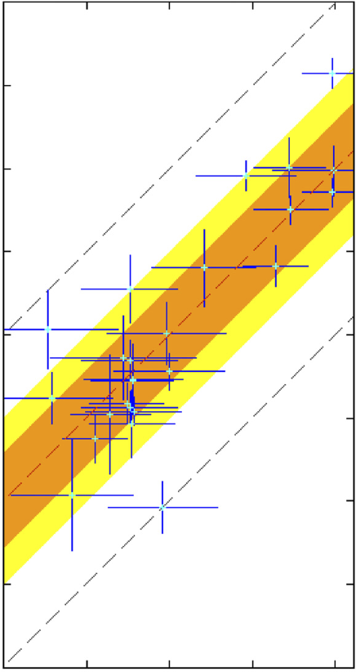
Large → medium scale: Consistent B-fields
Ambient 𝜽_{B-field} (deg) (deg)
0º
90º
180º
90º
Core 𝜽_{B-field} (deg)
0º
Li+ 2009
-90º
H.-b. Li+ 2009
Notes:
Orion Molecular Cloud region
-Optical polarimetry data: blue vectors
-Huge grey vectors: average of all blue vectors
-IRAS data: just to guide the eye (background image)
-CSO data: dust emission
-White vectors: average of CSO dust polarization
-ALL orientations are B-field directions
-Comparing with simulations, they find that a super-Alfvénic cloud (more turbulence than magnetic support) doesn’t fit well

Slide 34
Multi-scale comparisons: B-fields
> 1 pc
0.1 pc
1000 AU
100 AU
CONSISTENT
Hua-bai Li+ 2009

Slide 35
Multi-scale comparisons: B-fields
1 pc
0.1 pc
1000 AU
100 AU
(Not always) consistent
Hull+ 2013b (in prep)
Chapman+ 2013

Slide 36
Cores with consistent large-to-small B-fields
NGC 1333-IRAS 4A
Notes:
Other TADPOL future possibilities:
Intrinsic modeling of B-fields in cores (Fiege)
Constraints on B-fields in protoplanetary disks (Hughes)
Turbulence power spectra (Houde)
Larger scale background-star maps (Mimir, Jameson/Pillai/Clemens)

Slide 37
Cores with consistent large-to-small B-fields
NGC 1333-IRAS 4A
Notes:
Other TADPOL future possibilities:
Intrinsic modeling of B-fields in cores (Fiege)
Constraints on B-fields in protoplanetary disks (Hughes)
Turbulence power spectra (Houde)
Larger scale background-star maps (Mimir, Jameson/Pillai/Clemens)

Slide 38
Cores with consistent large-to-small B-fields
HH 211
Notes:
Other TADPOL future possibilities:
Intrinsic modeling of B-fields in cores (Fiege)
Constraints on B-fields in protoplanetary disks (Hughes)
Turbulence power spectra (Houde)
Larger scale background-star maps (Mimir, Jameson/Pillai/Clemens)

Slide 39
Cores with consistent large-to-small B-fields
HH 211
Notes:
Other TADPOL future possibilities:
Intrinsic modeling of B-fields in cores (Fiege)
Constraints on B-fields in protoplanetary disks (Hughes)
Turbulence power spectra (Houde)
Larger scale background-star maps (Mimir, Jameson/Pillai/Clemens)

Slide 40
Cores with INconsistent large-to-small B-fields
Ser-emb 6
Notes:
Other TADPOL future possibilities:
Intrinsic modeling of B-fields in cores (Fiege)
Constraints on B-fields in protoplanetary disks (Hughes)
Turbulence power spectra (Houde)
Larger scale background-star maps (Mimir, Jameson/Pillai/Clemens)

Slide 41
Cores with INconsistent large-to-small B-fields
Ser-emb 6
See also: Chapman+13
Notes:
Other TADPOL future possibilities:
Intrinsic modeling of B-fields in cores (Fiege)
Constraints on B-fields in protoplanetary disks (Hughes)
Turbulence power spectra (Houde)
Larger scale background-star maps (Mimir, Jameson/Pillai/Clemens)

Slide 42
Cores with INconsistent large-to-small B-fields
L1527
Notes:
Other TADPOL future possibilities:
Intrinsic modeling of B-fields in cores (Fiege)
Constraints on B-fields in protoplanetary disks (Hughes)
Turbulence power spectra (Houde)
Larger scale background-star maps (Mimir, Jameson/Pillai/Clemens)

Slide 43
Cores with INconsistent large-to-small B-fields
L1527
Notes:
Other TADPOL future possibilities:
Intrinsic modeling of B-fields in cores (Fiege)
Constraints on B-fields in protoplanetary disks (Hughes)
Turbulence power spectra (Houde)
Larger scale background-star maps (Mimir, Jameson/Pillai/Clemens)

Slide 44
Cores: B-field consistency
1
0 – 20º
0 – 45º
CDF
Random
ALL CORES
(consistent fields?)
0
Hull+ 2013b (in prep)
0º
𝜽_{small} – 𝜽_{large} (deg)
90º

Slide 45
Alignment vs. polarization fraction
• Core
⨉ Star-forming region
90º
Hull+ 2013b (in prep)
LO-POL
𝜽_{small} – 𝜽_{large} (deg)
45º
HI-POL
0º
Polarization %
1%
7%

Slide 46
Cores: two populations
HI-POL
(P ≈ 3 – 6%)
LO-POL
(P ≲ 3%)

Slide 47
Polarization “hole” effect
L1157
10%
HIGH %
Polarization %
LOW %
0%

Slide 48
Cores: two populations
HI-POL
(P ≈ 3 – 6%)
B_{sm} ∥B_{lg}
Outflows random w.r.t. B_{sm}
LO-POL
(P ≲ 3%)
B_{sm} ∦ B_{lg}
Outflows ⟂ B_{sm}

Slide 49
Multi-scale comparisons: B-fields vs. outflows
1 pc
0.1 pc
1000 AU
100 AU
Back to outflows!
RANDOM
Hull+ 2013a

Slide 50
Multi-scale comparisons: B-fields vs. outflows
1 pc
0.1 pc
1000 AU
100 AU
RANDOM
Or preferentially ⟂ ?
Hull+ 2013a

Slide 51
Multi-scale comparisons: B-fields vs. outflows
1 pc
0.1 pc
1000 AU
100 AU
Random (HI-POL)
⟂ (LO-POL)

Slide 52
Cores: B-field vs. outflow alignment
1
0 – 20º
0 – 45º
CDF
Random
ALL CORES
(random/misaligned?)
70 – 90º
0
Hull+ 2013b (in prep)
0º
𝜽_{outflow} – 𝜽_{B-field} (deg)
90º
Notes:
hi_pol = [ 'IRAS4A', 'HH211', 'L1157', 'MMS5', 'MMS6', 'CB230', 'SerEmb8', 'SerEmb8N' ]
lo_pol = [ 'CB26', 'CB54', 'IRAS2A', 'IRAS4B2', 'IRAS4B', 'L1448I', 'L1448N', 'L1455', 'L1527', 'L1551', 'VLA1623' ]

Slide 53
Cores: B-field vs. outflow alignment
1
0 – 20º
0 – 45º
CDF
Random
HI-POL
(random)
70 – 90º
0
Hull+ 2013b (in prep)
0º
𝜽_{outflow} – 𝜽_{B-field} (deg)
90º

Slide 54
Cores: B-field vs. outflow alignment
1
0 – 20º
0 – 45º
CDF
Random
70 – 90º
LO-POL
(misaligned)
0
Hull+ 2013b (in prep)
0º
𝜽_{outflow} – 𝜽_{B-field} (deg)
90º

Slide 55
HI-POL: B-fields random w.r.t. outflows
IRAS 4A
HH 211
Ser-emb 8
B-field
Outflow
OMC3-MMS6
Notes:
Other TADPOL future possibilities:
Intrinsic modeling of B-fields in cores (Fiege)
Constraints on B-fields in protoplanetary disks (Hughes)
Turbulence power spectra (Houde)
Larger scale background-star maps (Mimir, Jameson/Pillai/Clemens)

Slide 56
LO-POL: B-fields ⟂ outflows
VLA 1623
L1527
IRAS 4B
B-field
Outflow
L1551 NE
Notes:
Other TADPOL future possibilities:
Intrinsic modeling of B-fields in cores (Fiege)
Constraints on B-fields in protoplanetary disks (Hughes)
Turbulence power spectra (Houde)
Larger scale background-star maps (Mimir, Jameson/Pillai/Clemens)

Slide 57
HI-POL vs. LO-POL
IRAS 4A
Consistent B-fields
HI-POL
U_{B} > U_{dyn}
B-fields can resist twisting
from dynamic effects
Less line-of-sight twisting = higher polarization fraction
Consistent large-to-small-scale B-fields

Slide 58
HI-POL vs. LO-POL
IRAS 4A
HI-POL
U_{B} > U_{dyn}
B-fields can resist twisting
from dynamic effects
Less line-of-sight twisting = higher polarization fraction
Consistent large-to-small-scale B-fields
B-fields still are not correlated with outflows
Angular momentum direction unaffected by “global field”

Slide 59
HI-POL vs. LO-POL
L1527
LO-POL
U_{B} < U_{dyn}
B-fields are twisted by rotation
More line-of-sight twisting = lower polarization fraction
Inconsistent large-to-small-scale B-fields
INConsistent B-fields

Slide 60
HI-POL vs. LO-POL
L1527
LO-POL
U_{B} < U_{dyn}
B-fields are twisted by rotation
More line-of-sight twisting = lower polarization fraction
Inconsistent large-to-small-scale B-fields
B-fields are ⟂ to outflows
No longer looking at global field
This could aid in disk formation

Slide 61
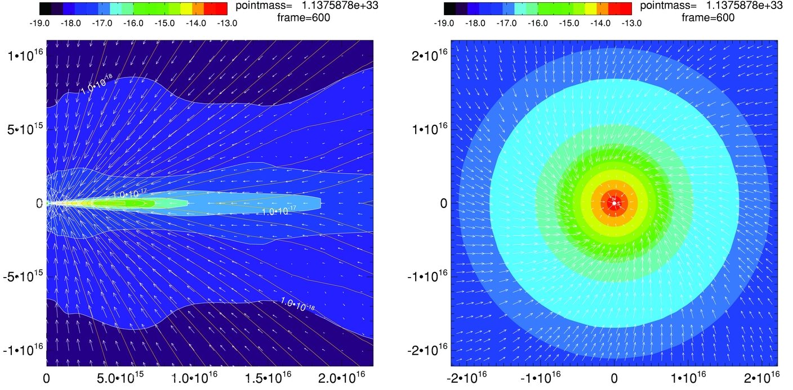
Magnetic braking catastrophe
Not rotationally supported!
Z.-Y. Li+2011

Slide 62
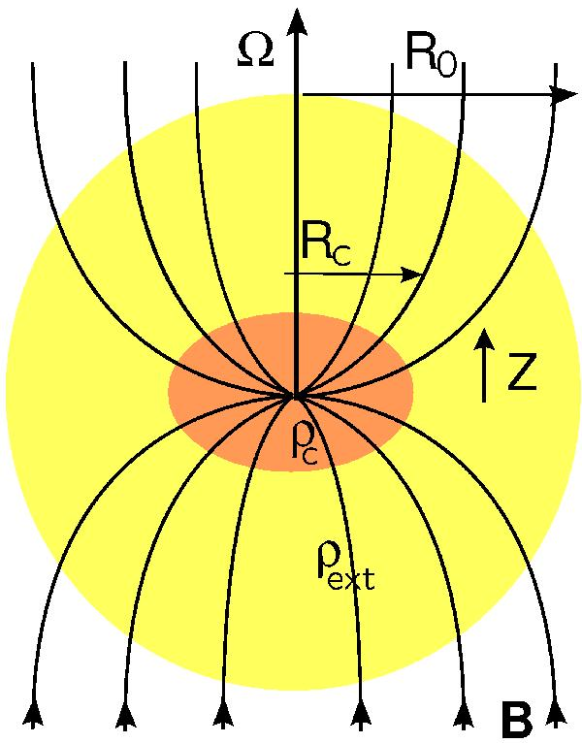
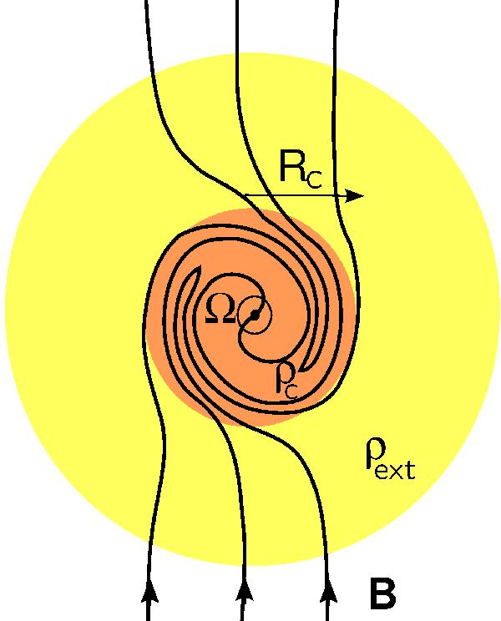
Magnetic braking catastrophe
Joos+2012
ALIGNED B-field & rotation
MORE magnetic braking
MISALIGNED B-field & rotation
LESS magnetic braking

Slide 63
LO-POL: B-fields ⟂ outflows
VLA 1623
L1527
IRAS 4B
B-field
Outflow
L1551 NE
Notes:
Other TADPOL future possibilities:
Intrinsic modeling of B-fields in cores (Fiege)
Constraints on B-fields in protoplanetary disks (Hughes)
Turbulence power spectra (Houde)
Larger scale background-star maps (Mimir, Jameson/Pillai/Clemens)

Slide 64
HI-POL vs. LO-POL: open questions
HI-POL
Are they younger?
Or have stronger B-fields?
Is our view is just dominated by the global field?
If so, are the fields actually twisted at smaller scales?
LO-POL
Are they older?
Or have weaker B-fields?
Are the twisted B-fields we see at 1000 AU consistent with B-fields at disk scales?

Slide 65
FUTURE multi-scale comparison: B-fields
?
1 pc
0.1 pc
1000 AU
100 AU
Machida+ 2006
180 AU
CARMA/SMA +
ALMA

Slide 66
Outline
Magnetized star formation
B-fields vs. outflows: multi-scale comparisons
Outflows/jets/disks and B-fields are randomly aligned (or perhaps ⟂?)
TADPOL survey
CARMA 1mm full-Stokes polarization system
B-fields: multi-scale comparisons
Cloud → core → envelope → disk
Two populations of cores: high and low polarization fraction
Back to outflows!
Disk formation implications
Star-forming regions

Slide 67
Alignment vs. polarization fraction
• Core
⨉ Star-forming region
90º
Hull+ 2013b (in prep)
SFRs
𝜽_{small} – 𝜽_{large} (deg)
45º
0º
Polarization %
1%
7%

Slide 68
Star-forming regions
DR21(OH)
Notes:
Other TADPOL future possibilities:
Intrinsic modeling of B-fields in cores (Fiege)
Constraints on B-fields in protoplanetary disks (Hughes)
Turbulence power spectra (Houde)
Larger scale background-star maps (Mimir, Jameson/Pillai/Clemens)

Slide 69
Star-forming regions
DR21(OH)
Notes:
Other TADPOL future possibilities:
Intrinsic modeling of B-fields in cores (Fiege)
Constraints on B-fields in protoplanetary disks (Hughes)
Turbulence power spectra (Houde)
Larger scale background-star maps (Mimir, Jameson/Pillai/Clemens)

Slide 70
Star-forming regions
NGC 7538
Notes:
Other TADPOL future possibilities:
Intrinsic modeling of B-fields in cores (Fiege)
Constraints on B-fields in protoplanetary disks (Hughes)
Turbulence power spectra (Houde)
Larger scale background-star maps (Mimir, Jameson/Pillai/Clemens)

Slide 71
Star-forming regions
NGC 7538 IRS 1
Notes:
Other TADPOL future possibilities:
Intrinsic modeling of B-fields in cores (Fiege)
Constraints on B-fields in protoplanetary disks (Hughes)
Turbulence power spectra (Houde)
Larger scale background-star maps (Mimir, Jameson/Pillai/Clemens)

Slide 72
Star-forming regions
W3(OH)
Notes:
Other TADPOL future possibilities:
Intrinsic modeling of B-fields in cores (Fiege)
Constraints on B-fields in protoplanetary disks (Hughes)
Turbulence power spectra (Houde)
Larger scale background-star maps (Mimir, Jameson/Pillai/Clemens)

Slide 73
Star-forming regions
W3(OH)
Notes:
Other TADPOL future possibilities:
Intrinsic modeling of B-fields in cores (Fiege)
Constraints on B-fields in protoplanetary disks (Hughes)
Turbulence power spectra (Houde)
Larger scale background-star maps (Mimir, Jameson/Pillai/Clemens)

Slide 74
Star-forming regions
W3 Main
Notes:
Other TADPOL future possibilities:
Intrinsic modeling of B-fields in cores (Fiege)
Constraints on B-fields in protoplanetary disks (Hughes)
Turbulence power spectra (Houde)
Larger scale background-star maps (Mimir, Jameson/Pillai/Clemens)

Slide 75
Star-forming regions
W3 Main
Notes:
Other TADPOL future possibilities:
Intrinsic modeling of B-fields in cores (Fiege)
Constraints on B-fields in protoplanetary disks (Hughes)
Turbulence power spectra (Houde)
Larger scale background-star maps (Mimir, Jameson/Pillai/Clemens)

Slide 76
Summary
B-fields are either preferentially misaligned (perp.) or randomly aligned with respect to outflows at the ~1000 AU scale
Thus, circumstellar disks are misaligned with fields in the cores from which they formed
High-pol sources: consistent large- to small-scale B-fields
Yet, outflows and B-fields are randomly misaligned
Global field doesn’t affect final angular momentum
Low-pol sources: inconsistent large- to small-scale B-fields
Outflows and B-fields are perpendicular
Could aid in disk formation
Questions:
Why are B-fields and outflows randomly aligned?
What will disk-scale B-field measurements show?
TADPOL outflows vs. B-fields: ApJ, 768, 159
TADPOL survey (CARMA key project): tadpol.astro.illinois.edu
Notes:
Other TADPOL future possibilities:
Intrinsic modeling of B-fields in cores (Fiege)
Constraints on B-fields in protoplanetary disks (Hughes)
Turbulence power spectra (Houde)
Larger scale background-star maps (Mimir, Jameson/Pillai/Clemens)

Slide 77
Fin

